Slide 1







Slide 2

E p h . 5 : 1 5 - 2 1
Bro. Abhishek

Slide 3
Outline
Walk
Walk Wisely
- do not live Carelessly
5:15-16
Walk in
Walk in the Will of God - do not live Confused
5:17
Walk in
Walk in the Spirit
- do not be Controlled by the world
5:18
Work
Work of Spirit-filled Life -
evidence of Spirit filled life 5:19-21

Slide 4

Making the Best use of the Time

Slide 5


Time Management?
Time Management is the strategic process of organizing and planning how to allocate one's time effectively for maximum productivity.
It involves, setting Priorities Creating schedules effectively using the time to maximize the Productivity in achieving desired goals.

Slide 6
The Truth about the Time !
•
Time is Precious
- Eph. 5: 15-16, , Ps. 90:12
“Time is more valuable than Money, you can get more money, but not more Time.”
– Tim Rohn
“Be very careful, then, how you live—not as unwise but as wise, making the most
of every opportunity, because the days are evil.” Eph. 5:16 NIV
Making the most of Every Opportunity… Time Management

Slide 7
Wanna know the worth of Time…?
The Cost of One Year - ask a detained student
The Cost of One Month
The Cost of one Day
The Cost of one hour
look at a Premature Baby
Ask a Bankrupt merchant
ask a man who suffered delayed treatment
The Cost of a Minute
The Cost of a Second
accident
The cost of a Milli second
ask a man who missed an imp. Flight/ train
ask a man who escaped a near death/
- ask the one who missed the Gold in

Slide 8
The Truth about the Time !
•
Time is Limited
-James 4:14, Ps. 39:4-5
Know the Brevity of Life
Life is very Short and truly Uncertain.
Take not the Time for granted:
  It cannot be Stopped
  It cannot be Stored
  It cannot be Stretched
  It cannot be Swapped
  It can be Stewarded well

Slide 9

TIME
MANAGEMENT
De Te CT i ng The Diffi CU LT i es
??

Slide 10

In order to manage your time more effectively, it is important to analyse where you are wasting time.
ECORD
NALYZE HANGE
KiLL The TiMe KiLLers

Slide 11




How to Manage the Time?
Prioritize
Plan
Perform

Slide 12

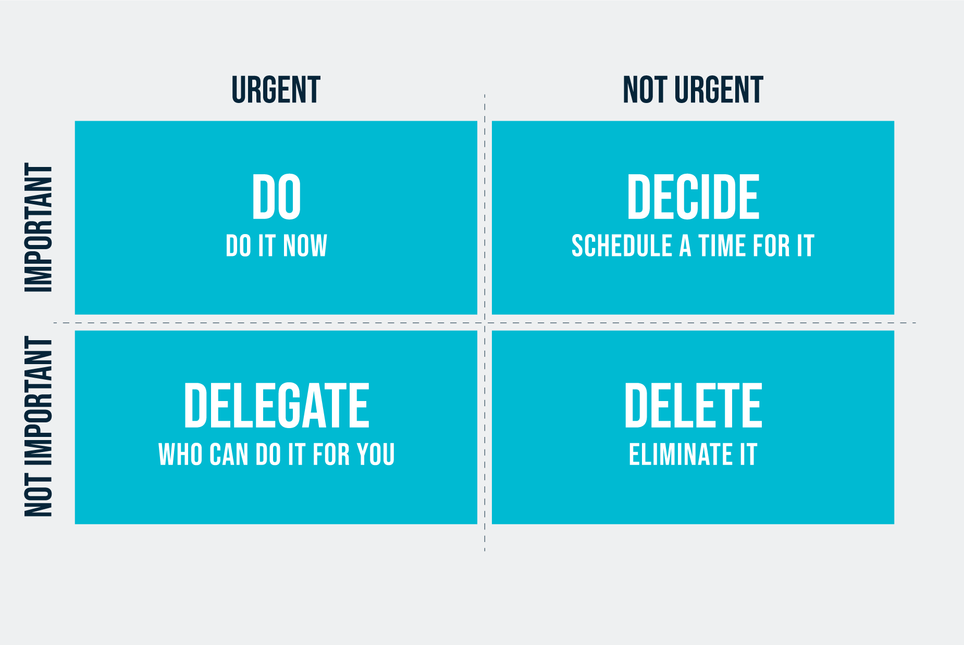
1. Prioritize your work
4D - Model
Pareto-Principle

Slide 13

2. Plan your Work
“If you Fail to plan, you plan to fail.”
Year Plan
Monthly plan
Weekly plan
Day schedule
Planning is Biblical…

Slide 14
3. Perform – Execute your plan
Plan & Action Plan
Do Not Procrastinate
  Tomorrow is not yours
  It is Sin
  It is Self
Do not Over Commit
Balance the Work and Rest
Review and Revise
( Vision & Mission)
Prov. 27:1
James 4:17
James 4:13-14

Slide 15
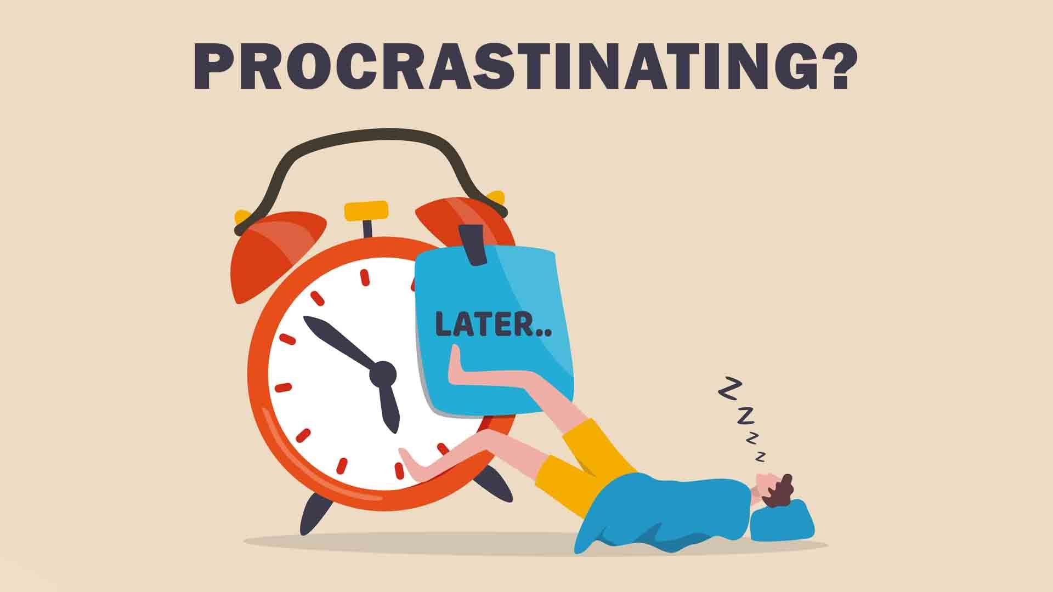
“Time management is really Personal management, Life Management and Management of Yourself.”

Slide 16

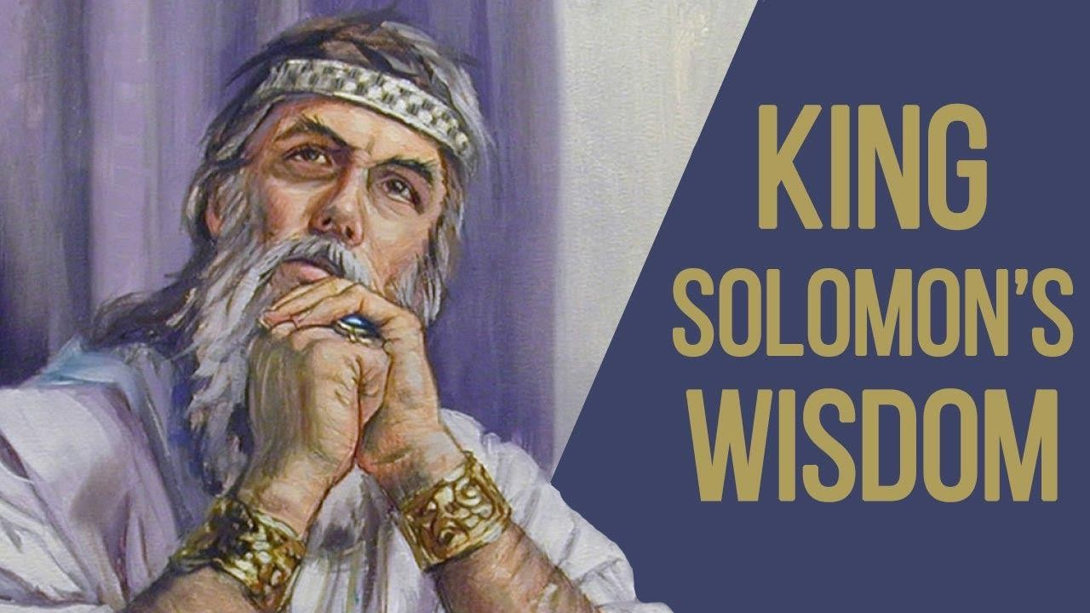
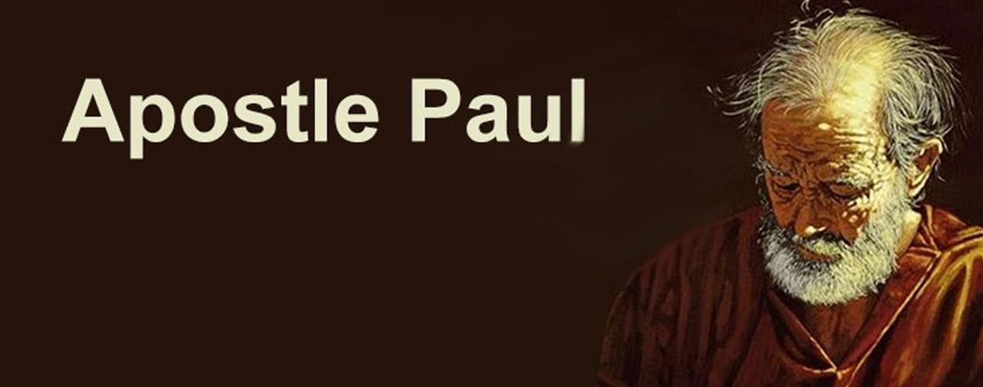
Case Studies
Example for a Wasted Life
Solomon
-
Example for an Invested Life -
St. Paul

Slide 17


Summary
Recognize the brevity of Life
Prioritize God’s Will
Redeem the Time
Overcome Procrastination
Be a good Steward of Time.
“ I think the hardest part of aging is, recognizing the time that you wasted and the things that you have worried about that really did not matter”

