Slide 1



. 1

Slide 2



QUIET TIME
- A time alone with God
Definition: An unhurried time of the day where you intentionally seek solitude in order to talk to and hear from God through prayer, the Bible, listening, and meditating.

Slide 3

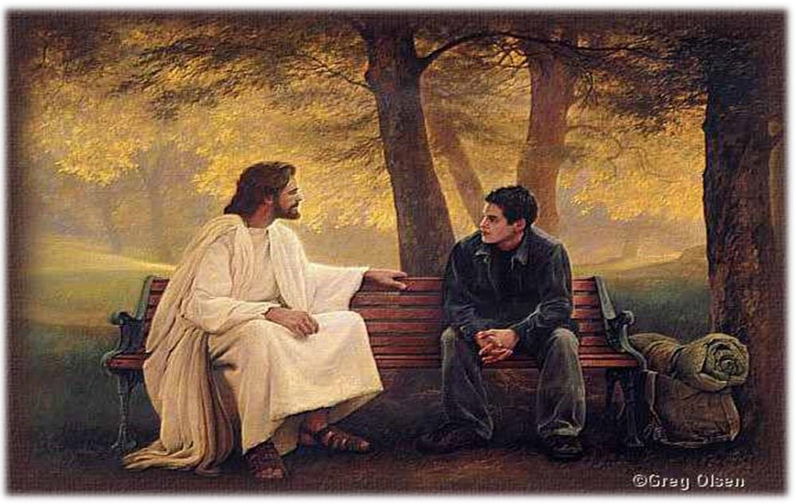
PURPOSE

Slide 4







Slide 5

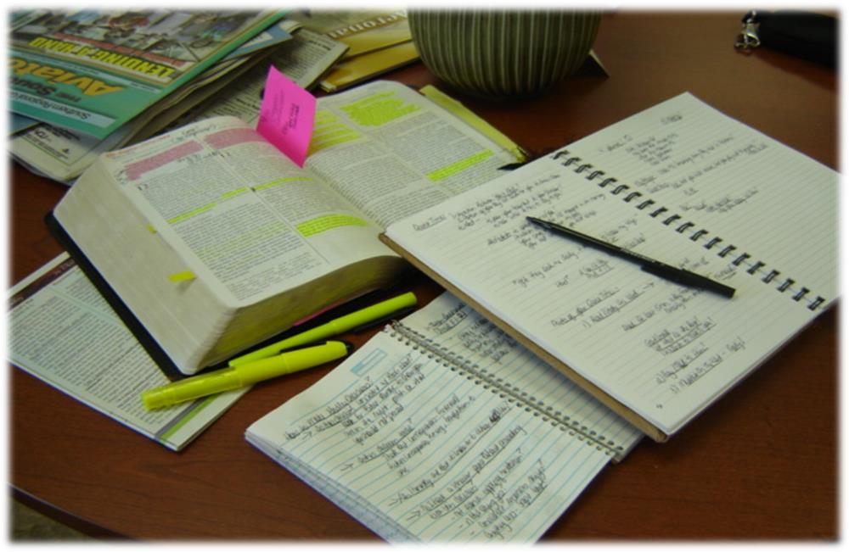
PREPERATION

Slide 6
























Q.T - SOUP
Scripture
  Pick the Right portion of the scripture
  pick the Right amount of the scripture
Observe
  Read it and Re-read the portion
Understand
  try to get the meaning of the text
Pray
  apply the Truth prayerfully.

Slide 7














“Quiet”
Find a PLACE where you can spend it alone with God, unhurried and without distraction.
  A priority for Jesus:
“Very early in the morning, while it was still dark, Jesus got up, left the house and went off to a solitary place, where he prayed.”
Mark 1:35

Slide 8








“Time”
Find a TIME and schedule it and stick to it, just as you would anything else in your life.
Find a regular time & start with a workable expectation.

Slide 9









“Time”
First ½ of your time:
Seek God in the Bible.
Second ½: of your time: Hear from and talk to God in prayer

Slide 10

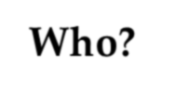



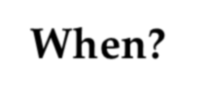


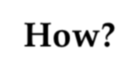
OBSERVE
Who?
What?
When?
Where?
Why?
How?

Slide 11







UNDERSTAND
What’s the context?
What is the passage saying?

Slide 12


















ASPECT
A – Attributes of God S - Sin to Avoid
P - Promises to Claim E - Example to follow C - Command to Obey T – Truth to know

Slide 13












Prayer
P – Praise R – Repent A – Ask
Y - Yield

Slide 14











Practical Tips
Too tired?
  Try to find a time during the day.
Lose focus when you pray?
  write down your prayers
  speak out loud
  use a pattern like A.C.T.S.

Slide 15






Practical Tips
Hard to find a “quiet time” because you have roommates?
  Find a place on campus
Don’t know where to start?
  Ask people here what they do

Slide 16












Not natural? Well, a discipline is like learning to play an
instrument …
“It takes 3 weeks for you to become familiar with a new task. Then it takes another 3 weeks before it becomes a comfortable habit. Many people never make it past the 6-week barrier of having a quiet time”
– Vineyard 201

Slide 17







Remember: Always Think About Why
You’re Doing This
A quiet time is not a time
for you to set aside to do something.
A quiet time is a time
for you to set aside to meet with Someone.

Slide 18




RELATIONSHIP
Will your quiet time be a
OR RITUAL

