Slide 1




Slide 2


Different names for Goal setting:
Call of God
Will of God
Mission
Bottom line
Vision

Slide 3

Prov. 2G:18
Where there is no vision, the people perish…

Slide 4


Slide 5


Slide 6
Is IT OkAY FOR A
ChRIsTIAN TO hAve GOAls ?

Slide 7
Is IT bIblIcAl TO hAve GOAls ?

Slide 8


Slide 9

So I run straiplst to the goa! With purpose i every step T ans not like a boxer af o m sses T+s p.x cases.
1 Cori«tT+ans 9:25

Slide 10
The Lord Jesus
Paul
Phil. 3:14
– John. 17:4
- 1Cor. 9:26 ,
IT Is
BIblIcAl ?
Abraham
Nehemiah walls
David
Mary
- Heb. 11:10
- to finish the
- Psalm 27:4
- Luke 10:42

Slide 11

Two Important Questions
1. Who am I becoming?
1. Am I fulfilling God’s call and purpose in my life?

Slide 12


Slide 13
Why Goal Setting?
It gives your life a Direction
It make your tomorrow better than today
It motivate those around you
It make one grow personally

Slide 14

How?

Slide 15
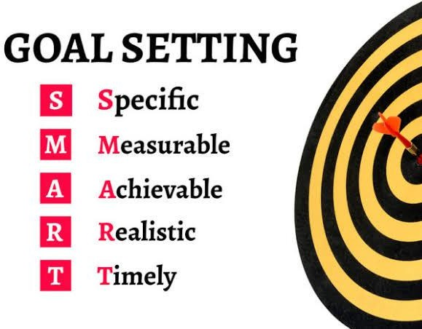

Slide 16
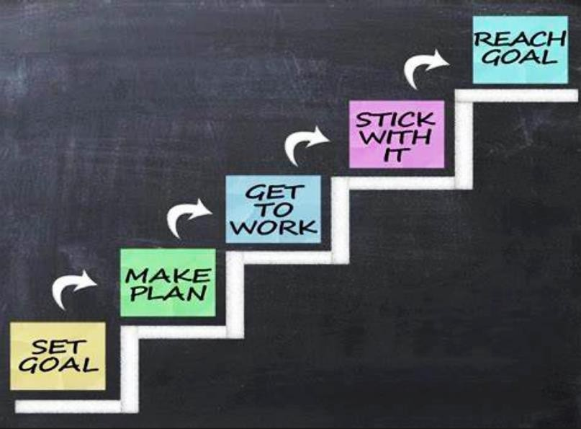

Slide 17


Slide 18
Common Goal for all Believers.
  To be like and to become like Christ
  To live a Holy Life
  To be regular in QT & PBS
  To be a Witness for Christ
  Etc.
GENERAL
GOAls

Slide 19
Specific Goals
Short term Goals
  Time span is short
  Immediate Action plans
  Clarity needed
  Contributes to the long term goal
Long term Goals
  For the long time (could be lifetime)
  May not have clarity on every details
  Persistence needed

Slide 20
Personal Life
Family Life
Professional life
Ministerial life
AReAs OF GOAl SeTTINg
Financial life
Social life

Slide 21


TAKE AWAY
You can have a Regular PBS
You can have a systematic study of BIBLE
you can start a prayer cell
You can Start a Bible study
You can Use your GIFT effectively in the Church
You can start a MENTORING

Slide 22
Life of PAUL
Eternity focused Goals
Be committed to fulfil
Put confidence on God
Phil. 3:10-11
Phil.3:12
Phil.3:7,9
Don’t be swallowed up by past Mistakes or Accomplishments
3:13-14 , 1Cor.2:4-5 , 2Cor. 4:7
Phil.

Slide 23
Practical Thoughts…
Have PRIORITIES to reach your Goal – Mt. 6:33
Use Gifts :
  Find out
  Fan out
Develop Skills Prov. 22:29
Periodical Self Evaluation is a Must…
Above all Discipline is the Key

