Slide 1


Slide 2


Mathetes (Gk):
Taught/ trained one.
A Learner under a teacher.
A Companion with a guru. (Mk. 3:14) to be with Him.
Discipleship?

Slide 3
Who is a Disciple?
The one who
LEARNS from
His Master
Mat. 11:29
The one who LIVES like His Master
John 15:8
The one who LEANS on his Master
John 8:31
The one who LOVES like his Master.
John 13:35

Slide 4
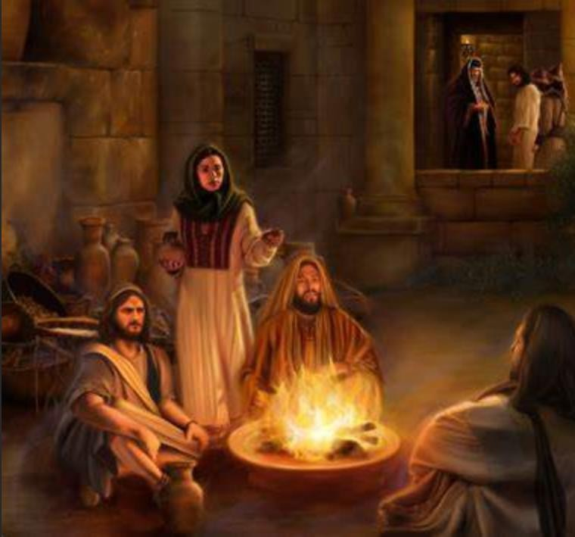
Are you one of this Man’s Disciple? - నీవును ఈ మనుష్యుని శిష్యులలో ఒకడవా?
We know Peter’s reply on that day, what is your answer today?
“Are you one of this Man’s Disciple?”
John 18:17
Christians Vs. Disciple
Faith (belief) without works (behavior) is Dead. James 2:17
Great omission of the Great Commission – Discipleship.

Slide 5
And he said to all, “If anyone would come after
me, let him deny himself and take up his cross
daily and follow me.
Luke 9:23

Slide 6

And he said to all,
- Universal Call
If anyone - Personal Commitment
let him … take up his cross - Cost of the Call
Daily - not as an occasion , but as a vocation. Follow Me - not a set of principles, but a Person.

Slide 7
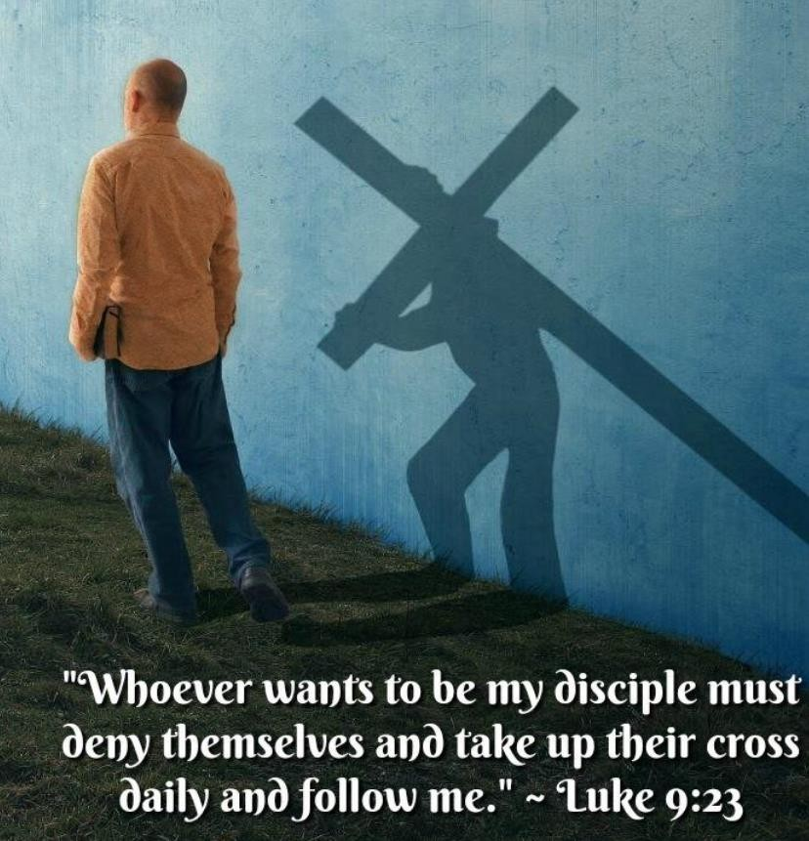
A Call to Discipleship
Come unto Me
Come after Me
Mt. 11:28
Lk. 9:23
Come unto me Vs. Come after me.
Outside group Vs. Inside Group
To Faith
To Sonship
to Laydown Vs. to Take up
Vs. to Follow
Vs. to Discipleship
Four stages of Discipleship:
Come & See –> Follow Me –> Go & Make –> Feed my lamb
An invitation from a King is a Direct Command

Slide 8

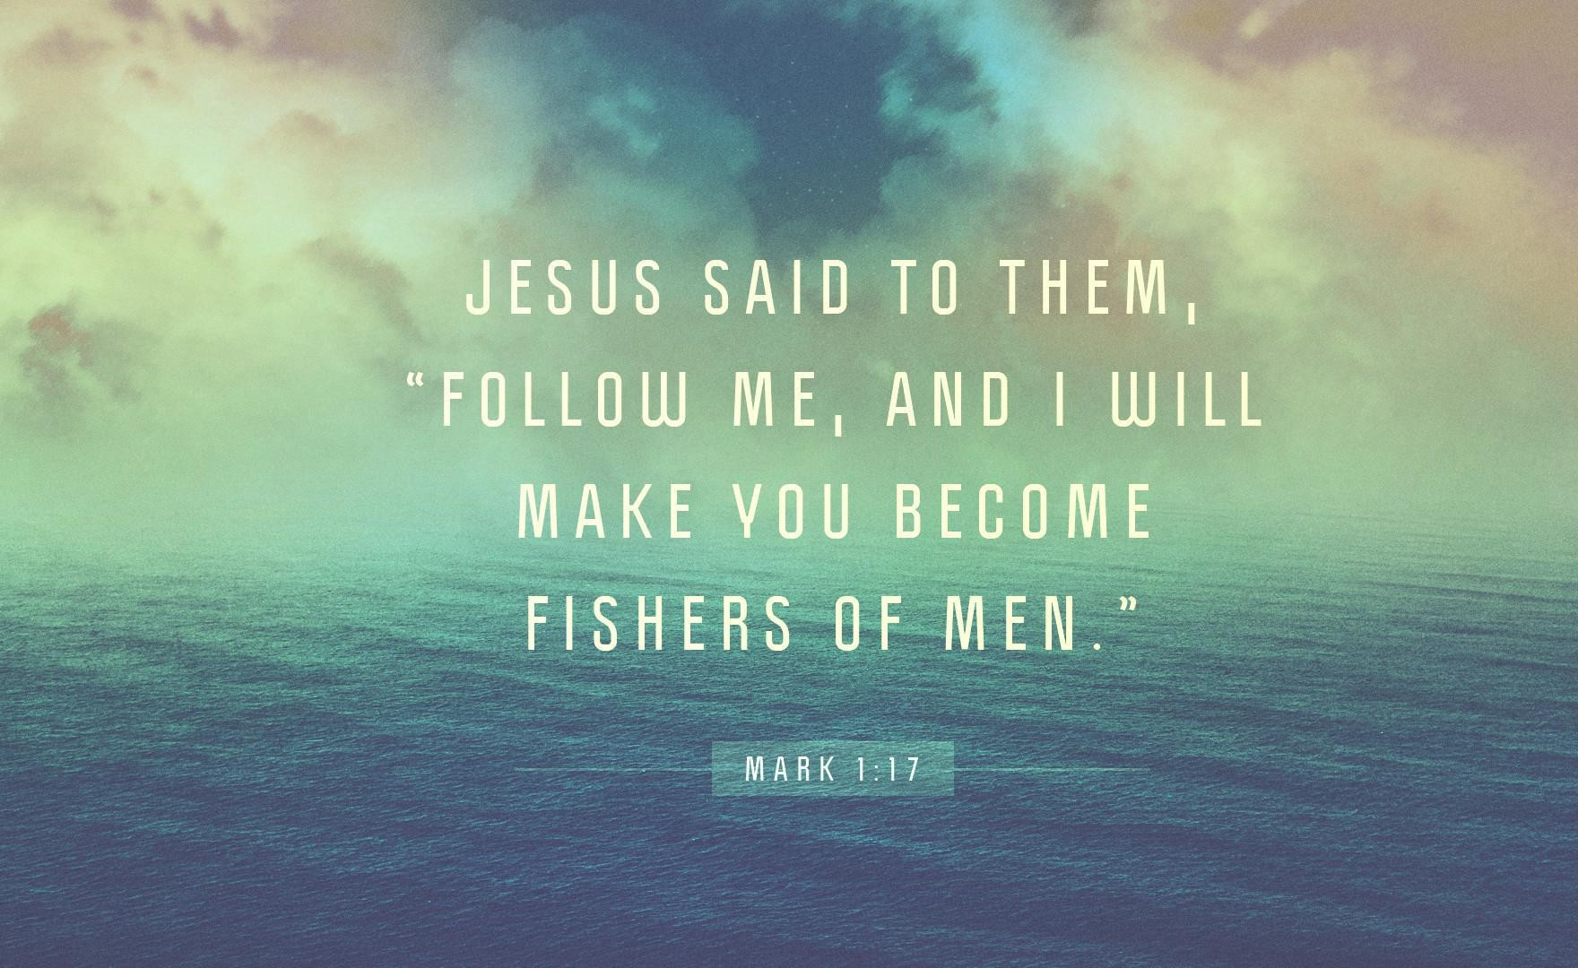
Follow Me, I will make you...
A Personal Call
- “Follow Me”
A Purposeful Call
- “I will Make..”
A Promised Call
- “ I will..”

Slide 9
Luke 9:23

Slide 10

Cost of discipleship -Luke 9:23
Rejection of Self
  What self Denial is all about?
Reception of the Cross
“let him deny himself”
“SELF”
“take up his own Cross and follow”
Identification.
Submission.
Laying on the altar.
Repeat the same
  Day after day
  Step by step
(Embracing the Cross Vs. Enemies of the Cross) (yet not my will but thy will)
(as a living Sacrifice)
- “daily”
Daily dying is the secret of daily living.
Fans Vs. Followers

Slide 11
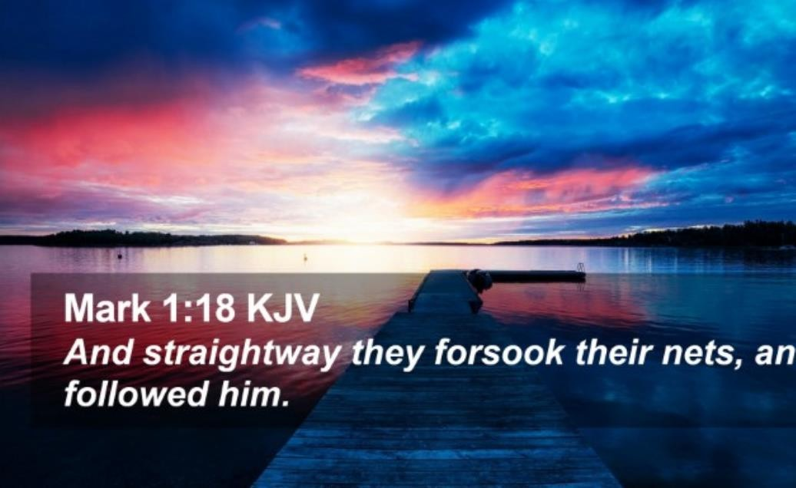
Forsake to Follow…
You can’t follow unless you forsake.
You can’t serve two Masters.
What is that one thing, that you could not forsake till now?
Rich Young Ruler…
If you can’t forsake, you need to forsake the Lord.

Slide 12

Test of a
Luke 14:26-33

Slide 13
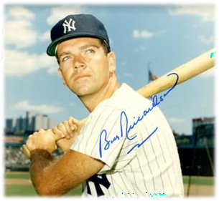
Three Tests of Discipleship
Love Test -Relationship Luke.14:26
  “if anyone comes to me and does not hate his own father and mother and wife and children and brothers and sisters, yes, and even his own life, he cannot be my disciple.” hatred - (lesser love compared to all Mt. 10:37)
Lordship Test -Lordship Luke. 14:27
  “whoever does not bear his own cross and come after me cannot be my disciple.”
  “if He is not the Lord of all, He is not the Lord at all.”
Loyalty Test -Stewardship Luke. 14:33
  “so therefore, any one of you who does not renounce all that he has cannot be my disciple.”
  Rich young Ruler.
“Dear Lord, Your will, nothing more, nothing less, and nothing else. Amen” – Bobby Richardson

Slide 14

John 8:31
John 13:35
John 15:8
-one who Learns from the Lord
-one who Loves the Lord above all
-one who Lives a Life to reproduces

Slide 15

A Disciple is a good learner
A Learner who is Receptive
Take my yoke upon you, Learn of Me;
- John 8:31
- Mt. 11:29
“If You abide in my word, then you are my disciples indeed.”
Teacher
Textbook
Test
Jesus Christ (my disciples)
The Bible (my word)
Obedience (abide/continue)
Hearers Vs. Doers of the Word
A young woman –book - boring and dull – husband – fascinating.
Dusty Bibles – Dirty lives.
One woman, read the Bible for more than 100 times…

Slide 16

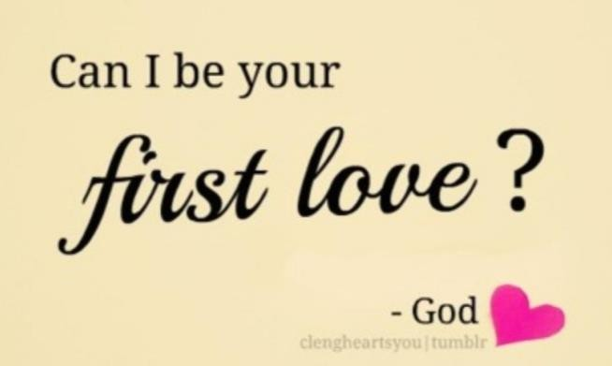
A Disciple Loves His Master above all
A Lover who is Reflective
- John 13:35
“by this all people will know that you are my disciples,
if you have love for one another.”
Love is Demanded | - a new commandment | 13:34
Love is Divine | - just as I have loved you 13:34
Love is Displayed | - love one another
1Cor. 13:4-8: we see 7 negatives (do nots) and 7 positives about divine love.
What a perfect balance!
We are the mirrors to reflect the divine love in this loveless world.

Slide 17
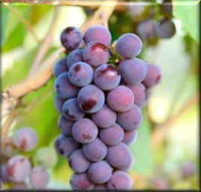
A Disciple makes another Disciple
A Life that is Reproductive
- John 15:8
“By this my Father is glorified, that you bear much fruit and so proved to be my disciples.”
I am the True Vine - the source of life
There is False vine also- Duet. 32:32-33
Who your source of life is decides what fruit you bear.
Self Productive fruit
Spirit Produced Fruit
Gal.5:19-21 Gal. 5:22-23
Obedience is the Key to bear much fruit - Alexzander and army.
Goal of Discipleship - be a disciple and make disciples - the glory of God.

Slide 18

Enemies to Discipleship
Hindrances to Follow Jesus
Luke 9:57-62

Slide 19
Enemies to Discipleship
1. Mr. Impulsive - too Swift to follow
  It’s not just an impulsive/emotional decision.
2. Mr. Indifferent - too Slow to follow
  let me go and …first. (lack of Priority)
3. Mr. Indecisive - too Soft to follow
Burn the bridges behind…
I just can’t make my mind…
The dangerous “But s” in life.
Lk. 9:57-58
Lk. 9:59-60
Lk. 9:61-62

Slide 20


